Slide 1




NEXT GEN EMPLOYABILITY PROGRAM
Creating a future-ready workforce
Team Members
College Name
Student Name : BINCY DAS K S
Student ID : au960221243013
Arunachala College of Engineering for Women

Slide 2

CAPSTONE PROJECT SHOWCASE
Project Title
Car Rentals Application with Django Framework
Abstract | Problem Statement | Project Overview | Proposed Solution | Technology Used | Modelling & Results | Conclusion

Slide 3
Abstract
In this project, we present the development of a Car Rentals Application using the Django framework.
The application aims to facilitate the process of renting cars for both customers and rental agencies.
The primary features of the application include user authentication, a user-friendly interface for browsing available cars, booking functionalities, payment integration, and administrative tools for managing rentals and vehicle inventory.
Through this project, we aim to provide a comprehensive solution for car rental businesses, streamlining the rental process for both customers and agencies while maintaining scalability, security, and user satisfaction.
Source :

Slide 4
Problem Statement
To create a car rental application with Django framework for managing and organizing car rental services. Developed to address the increasing demand for streamlined and user-friendly car rental solutions using python and django. Developing a modernized car rental service that leverages technology to streamline booking processes, enhance fleet management, improve customer service, and provide transparent pricing can significantly improve the overall rental experience for customers and rental agencies alike.
Source :

Slide 5
Project Overview
The aim of this project is to develop a comprehensive and user-friendly car rental service that leverages technology to overcome the challenges faced by traditional rental services. The project will focus on providing a seamless and efficient experience for both customers and rental agencies by implementing the following key features:
User-Friendly Interface
Transparent Pricing
Wide Vehicle Selection
Customer Support and Assistance
Feedback and Review System
Source :

Slide 6
Proposed Solution
.
Our solution focuses on enhancing accessibility, transparency, convenience, and customer satisfaction through innovative technology and user-centric features. We're committed to simplifying your journey and making every ride with us a memorable and enjoyable experience. Here's an overview of our proposed solution:
24/7 Customer Support:
Feedback and Improvement:
Smart Fleet Management:
Source :

Slide 7
Benefits of a Car Rental Service Application:
Convenience
Time-Saving
Wide Selection
Transparency
Accessibility
Efficient Management
Customer Satisfaction
Data Insights
Cost Reduction
Customer Support
Overall, a car rental service application offers numerous benefits for both customers and rental agencies, including convenience, time savings, transparency, accessibility, efficiency, and enhanced customer satisfaction.
Source :

Slide 8
Key components
User Authentication and Profile Management
Vehicle Inventory Management
Fleet Tracking and Management
Customer Support and Communication
Feedback and Review System
Administrative Dashboard
Mobile Accessibility
Security Features
These key components collectively form the foundation of a comprehensive car rental service application, providing users with a seamless and efficient rental experience while enabling rental agencies to manage their operations effectively.

Slide 9


Technology Used
Front-end
Back-end
Source :

Slide 10
Modelling & Results
Modeling and Results in a car rental service application involve creating data models to represent various aspects of the rental process and analyzing outcomes to optimize service delivery and customer satisfaction. Snapshots of the model is shown as below.
Source :

Slide 11
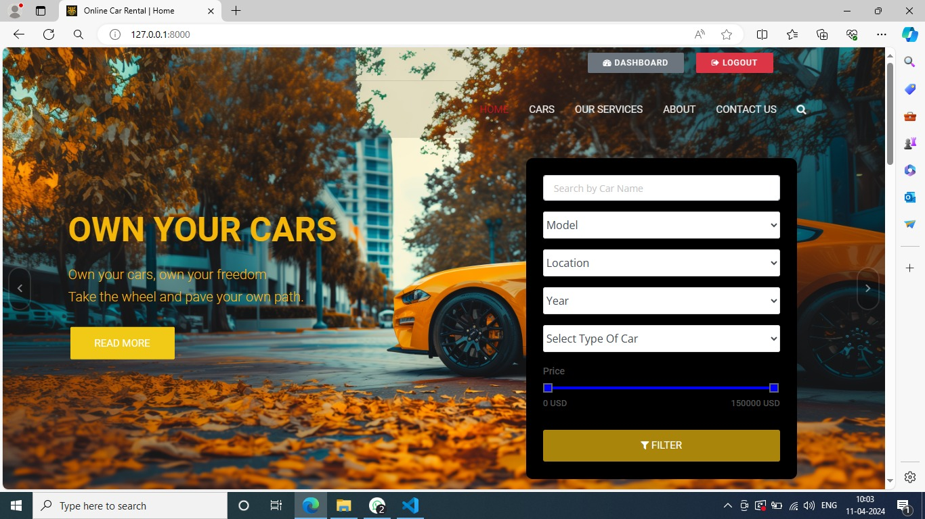
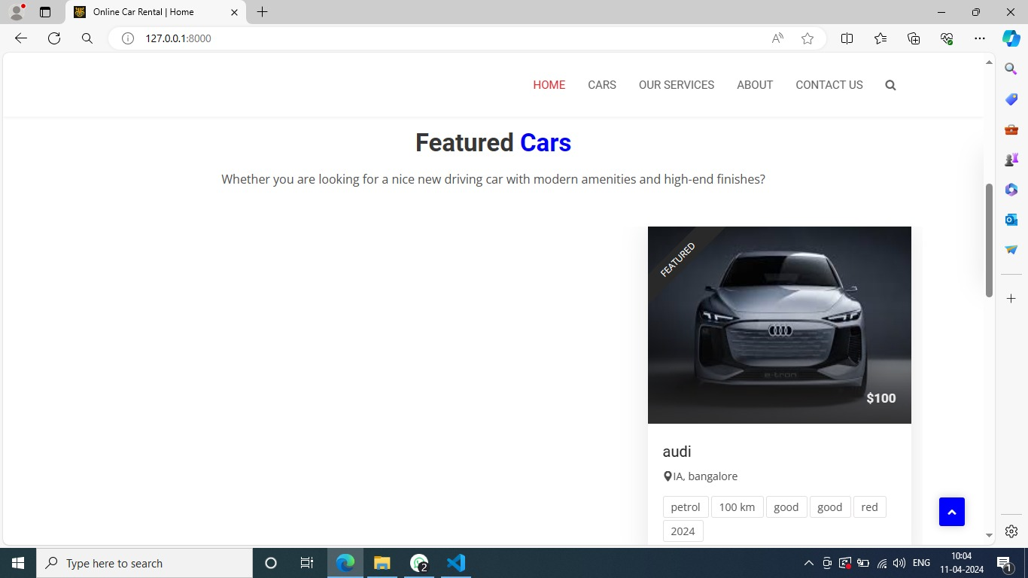
Homepage

Slide 12
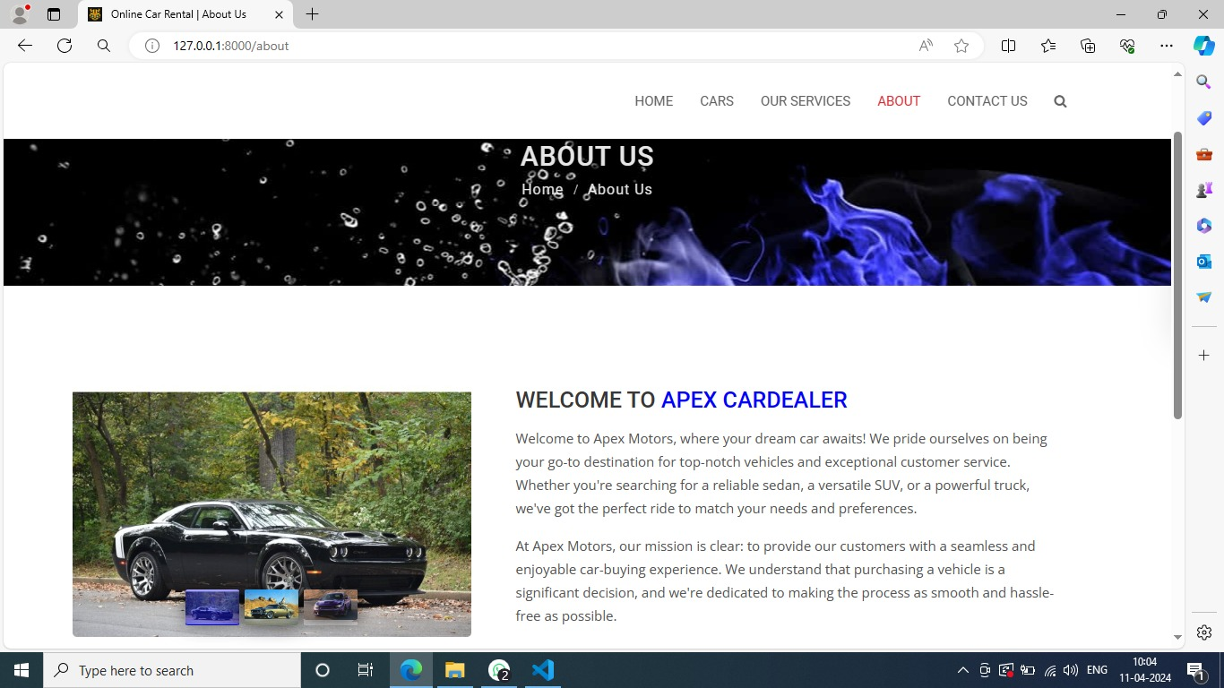
About-Us-Page

Slide 13
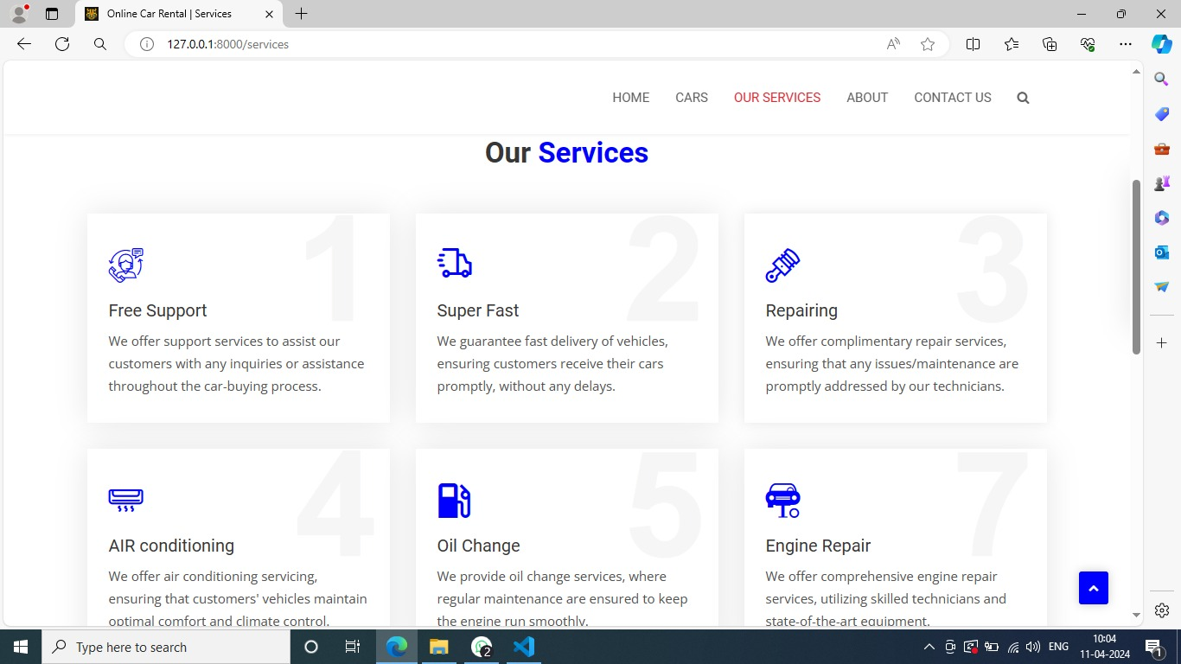
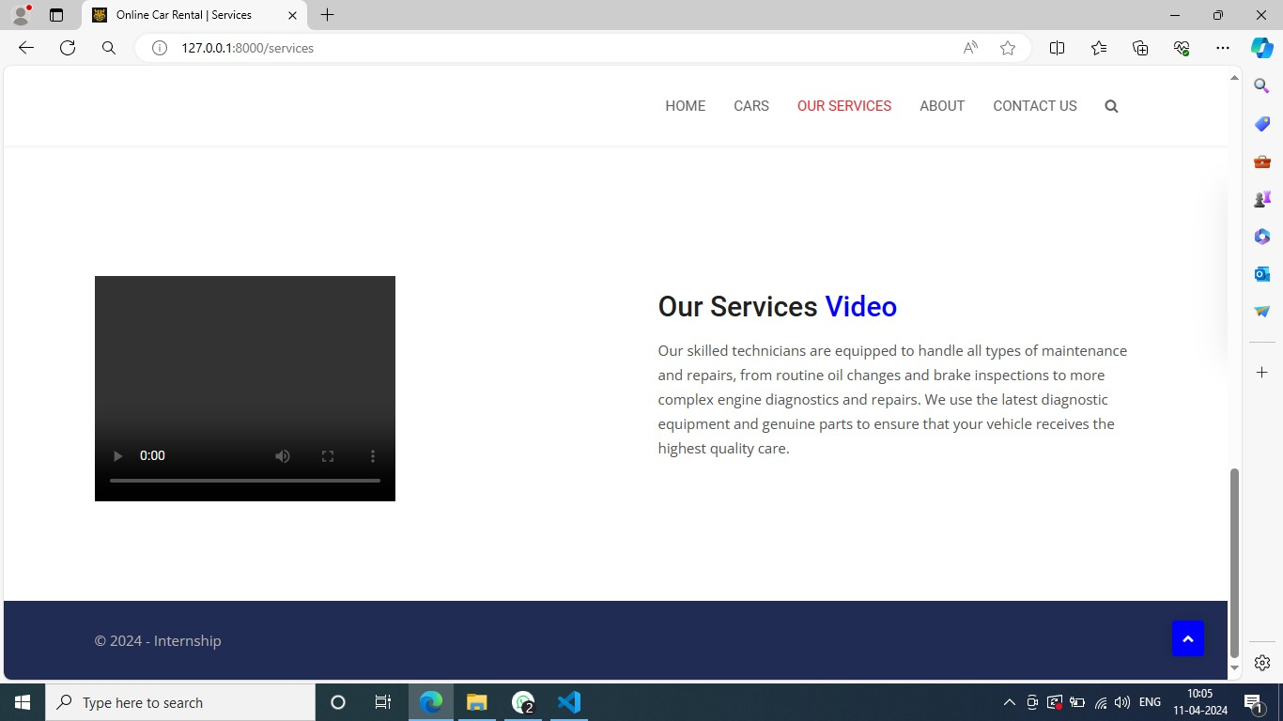
Service-Page

Slide 14
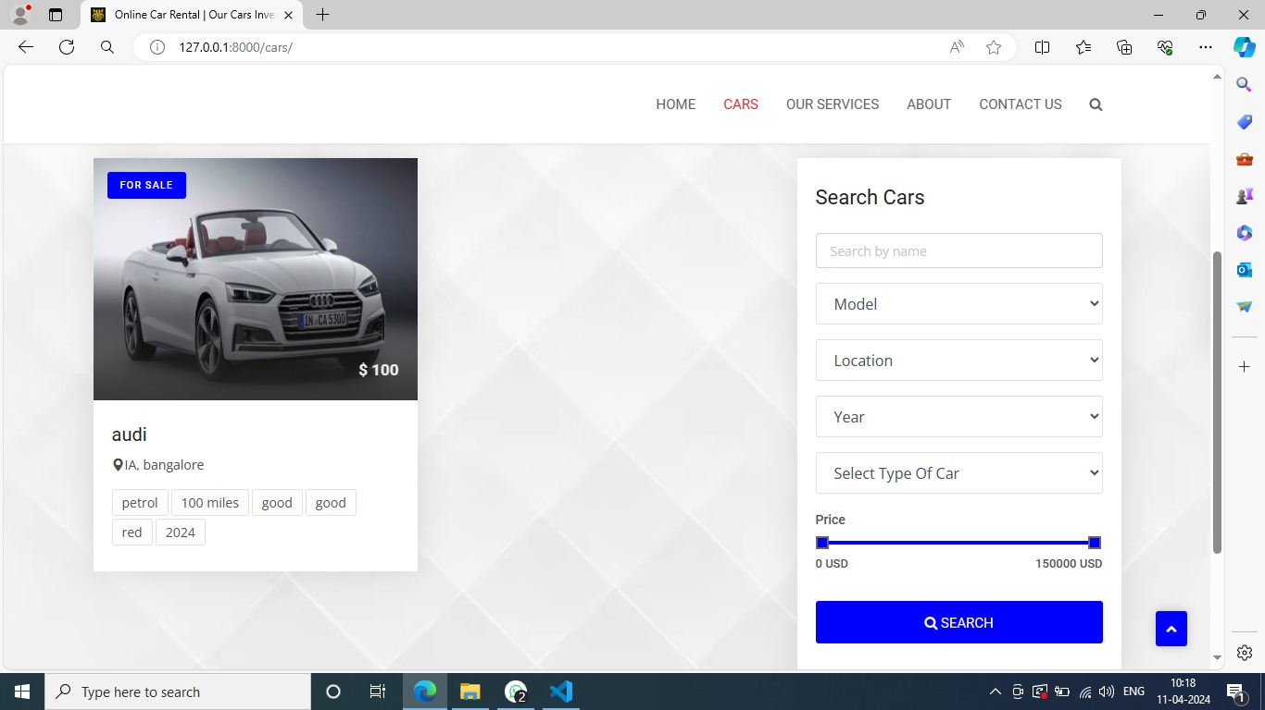
Cars-Page

Slide 15
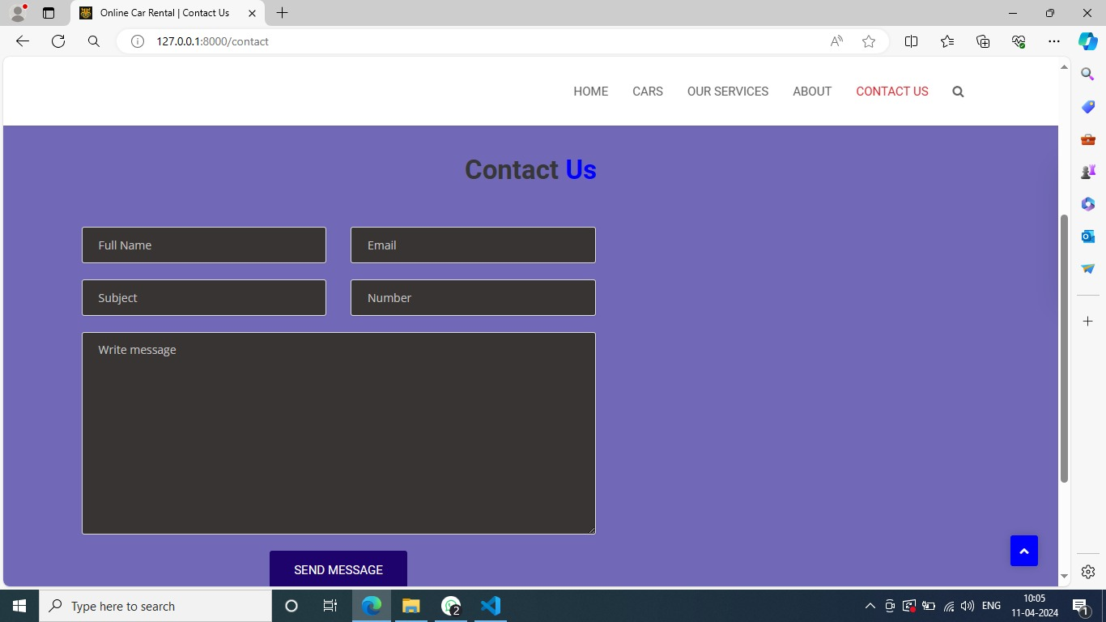
Blog-Page

Slide 16
Future Enhancements:
In the near future we try to improve the application by adding more features to it like:
Advanced AI Chat bots
Virtual Reality Showrooms
Integrated Financing and Insurance Solutions
Enhanced Mobile Experience

Slide 17
Conclusion
The Car rental application is very a useful application in the current environment
The main advantage of it, is provides the remote location access this the high needs of the today’s generation people
We also provided with the friendly user interface.
Easy to access by all the people.
Source :

Slide 18
Thank You!
Notes:
Thank You !!

